Slide 1

PROPER GLOVE
Project ID: 20_21-J 17

Slide 2
Agenda
01
Overall Presentation
02
Member 01 Presentation
03
Member 02 Presentation
04
Member 03 Presentation
05
Member 04 Presentation

Slide 3
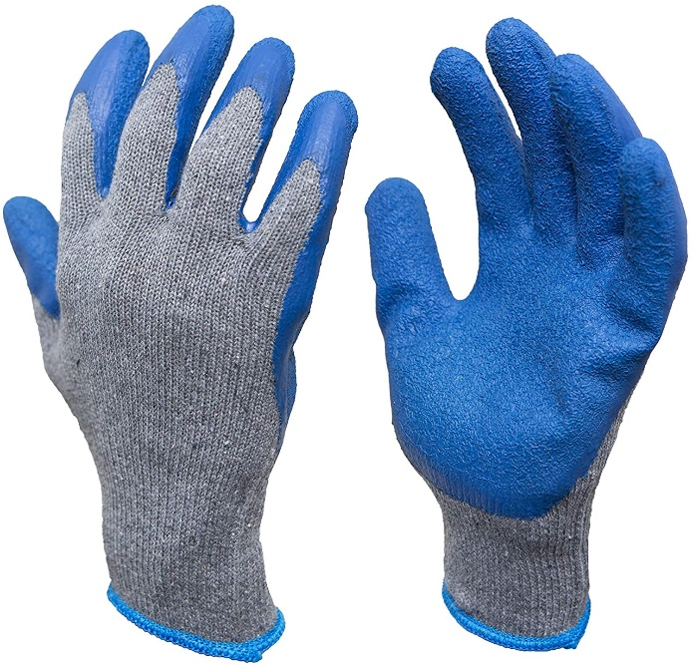
Overall Introduction
Supported Glove is an external wear, which protect hand from hazards.
100% quality product is an essential feature in global industrial safety glove market.
Defect’s occurrence in ongoing manufacturing process is a major drawback in production.
Maximum reliability in data communication through network can increase plant production process.

Slide 4
Problem
Manual quality assurance used in current system. It is time consuming and difficult to manage large amount of production.
S
W
The changes of the plant parameters due to environmental changes can cause to produce the gloves with defects.
STRENGTHS
OPPORTUNITIES
WEAKNESS
THREATS
Glove can be defect due to chemical changes it cannot be controlled every time
O
T
Current data communication system is not reliable.

Slide 5

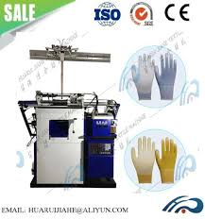
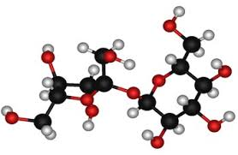

Goals
A Better QA system for MIDAS SAFETY using computer vision will ensure a quality product and improved production rate. It helps to reduce their cost and increase profits.
Desktop application with machine learning approach to optimize the causes for defect occurrence and glove rejection by providing maximum accuracy.
Design Proper glove system to optimize manufacturing process according to the client requirement within the 9 months’ period.
Effectively manage the chemical defects during the glove manufacturing process using machine learning model
Develop Data warehouse and build communication protocol to improve network performance

Slide 6
What is ?
A smart system, which will optimize
the production of supported gloves,
by combining Data Science & Networking approaches.

Slide 7
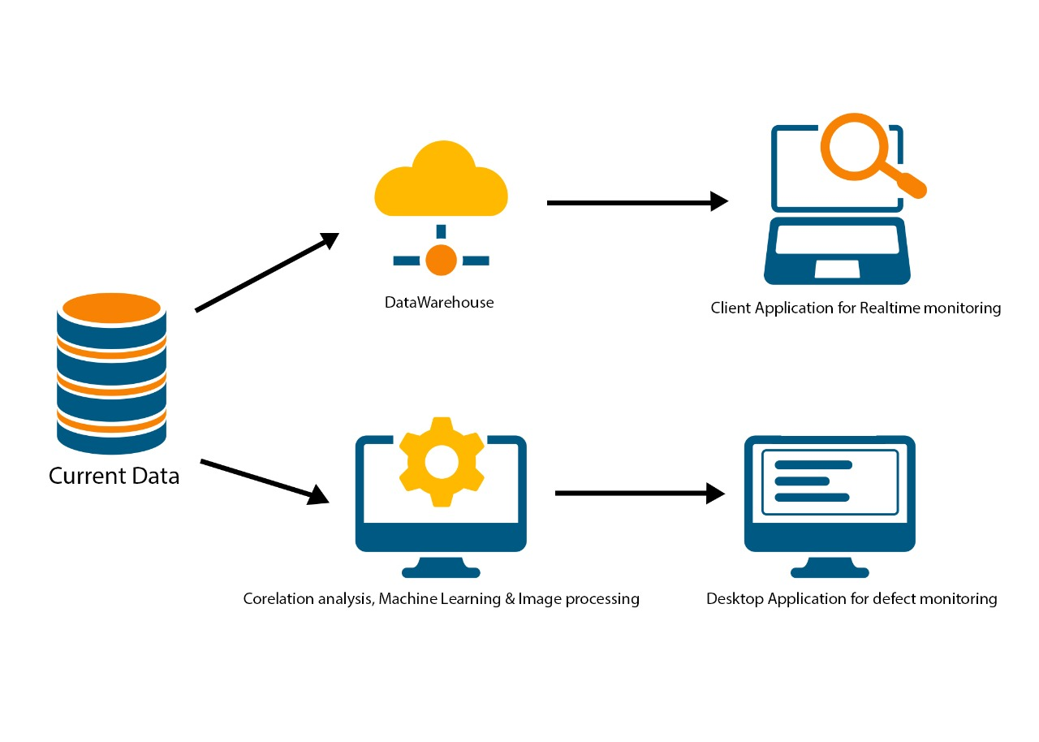
System Overview Diagram

Slide 8
IT17181402 | ALWIS D. G. Y. C. K
DATA SCIENCE
IT17181402 | ALWIS D. G. Y. C. K | 20_21-J 17

Slide 9
Background study.
Data collection.
Data Preparing
IoT model implementation
Model implementation
Testing
Overall Progress
Completed tasks
On going tasks
Tasks yet to start
IT17181402 | ALWIS D. G. Y. C. K | 20_21-J 17

Slide 10
Background
MIDAS Safety is a leading glove manufacturer in Sri Lanka. The newly created plant 13 is conducting the manufacturing process with state-of-the-art technologies. But the QA system in the plant 13 is perform as a manual process which is labor intensive and time consuming
IT17181402 | ALWIS D. G. Y. C. K | 20_21-J 17

Slide 11
Problem
Can the pretrained models can be used to predict/detect defects in gloves using custom data ???
How to optimize the accuracy and the performance of the pretrained models ???

Slide 12
Gap
Image technologies used in vast coverage of industries and new image technologies are focuses on the mobile and efficacy and use of glove manufacturing has not been teste.
IT17181402 | ALWIS D. G. Y. C. K | 20_21-J 17

Slide 13
Objectives
Building convolutional neural networks models
Data collection
Data preprocessing / Augmentation
Build models (VGG19, VGG16, Xception, Resnet50, Resnet101)
Test models
IoT implementation
Select suitable IoT device
Install & prepare for model integration
Integrate models to the IoT Module
Test model accuracy and performance
IT17181402 | ALWIS D. G. Y. C. K | 20_21-J 17

Slide 14
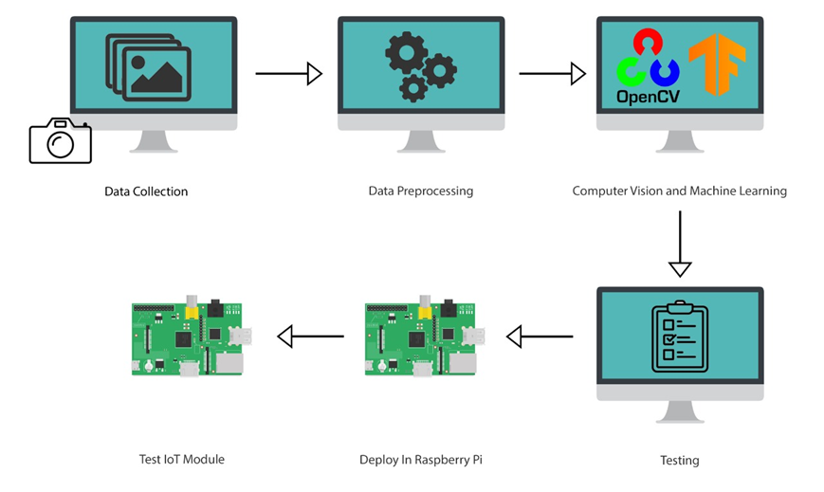
Methodology
/ Augmentation
System Overview Diagram

Slide 15
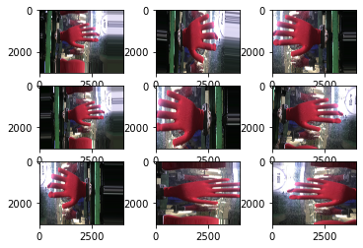
1. Data Preprocessing
In the preprocessing stage image augmentation were used to improve defect detection rate.
This methods is effective and efficient for large number of images.
The process create several images from one input image and the process executes at the model
training stage
IT17181402 | ALWIS D. G. Y. C. K | 20_21-J 17

Slide 16
2. Model Implementation
Create an image batch operation which takes batches from the augmented data
Remove pretrained top (predictive) layers from the selected model
Execute a predictive cycle to extract features from the pretrained model
Creates custom Sequential model for related classes and train with the extracted features
Create a combined model with pretrained model
Train the hybrid model
Predict accuracy
Image processing models
Xception
Resnet50
Resnet101
VGG16
VGG19

Slide 17
3. Accuracy Report
Model | Accuracy
VGG19 | 0.9913
VGG16 | 0.9710
Xception | 0.9451
Resnet101 | 0.6942
Resnet50 | 0.6026

Slide 18




Tools & Technologies
Transfer Learning
Tensorflow
Keras
OpenCV
Spyder IDE
Anaconda
NVIDIA CUDA
CuDNN

Slide 19
Requirements
User Requirement
Proper QA system with low cost
Flexible API for autonomous system
Building a QA system using computer vision and IoT
platform
Functional and Non-functional Requirement
Reliability
Availability
Usability
IT17181402 | ALWIS D. G. Y. C. K | 20_21-J 17

Slide 20

Automated QA system can be used in many industries to control their quality of the products because of that they can reduce the expenses of QA, reduce man hours and human errors.
Product
One in ten organizations are now using AI or machine learning technologies to improve their day to day operations such more and more organizations tend to migrate from old systems to modern AI and machine learning technologies
Customer
Future Demand
MAIDAS SAFETY manufacturer can use automated QA system to manage the quality of their products that really helpful to control the high quality of large amount of production.
IT17181402 | ALWIS D. G. Y. C. K | 20_21-J 17
Commercial Value

Slide 21
References
[1] "MIDAS SAFETY," MIDAS SAFETY, [Online]. Available: https://www.midassafety.com/. [Accessed 28 July 2020].
[2] B. G. Dale, Managing Quality, Malden: Blackwell Publishing Ltd, 2003.
[3] J. A. G.-R. V. K. M. K. L. Ploytip Jirasukprasert, "A Six Sigma and DMAIC application for the reduction of defects in a rubber gloves manufacturing process," p. 21, 2013.
[4] "Defects Reduction Using Root Cause Analysis Approach in Gloves Manufacturing Unit," International Research Journal of Engineering and Technology, vol. 3, no. 7, p. 11, 2016.
[5] S. Moraes, "Wonders in Image Processing with Machine Learning," Medium Inc., 20 November 2019. [Online]. Available: https://medium.com/@ODSC/wonders-in-image-processing-with-machine-learning-9c6f2e070e99. [Accessed 27 July 2020].
[6] qmatrix, "Medical Gloves Inspection," 6 November 2017. [Online]. Available: https://www.inspection-india.com/blog/medical-gloves-inspection/. [Accessed 23 07 2020].
[7] Keras.io, "Keras," [Online]. Available: www.keras.io. [Accessed 16 02 2021].
[8] Google Inc, "Tensorflow," Google Inc, 09 11 2015. [Online]. Available: https://www.tensorflow.org/. [Accessed 16 02 2021].
IT17181402 | ALWIS D. G. Y. C. K | 20_21-J 17

Slide 22
IT17175012 | FERNANDO W.M.N.A
DATA SCIENCE
IT17175012 | Fernando W.M.N.A | 20_21-J 17

Slide 23
Background study.
Site visit for data collection.
Data Pre-Processing
Interface design
Correlation analyze between parameters.
Machine learning model implementation
Documentation
Overall Progress
Completed tasks
On going tasks
Tasks yet to start
IT17175012 | Fernando W.M.N.A | 20_21-J 17

Slide 24
Background
The glove manufacturing is performed under the environmental condition and internal parameters of the factory.
It is essential to maintain plant parameter within the required levels to ensure the manufacturing process is happening smoothly.
Due to the uncontrollable variations in plant parameters, defects are occurred in final product.
Although there are different kinds of defects only few identified defect cause for glove rejection.
IT17175012 | Fernando W.M.N.A | 20_21-J 17

Slide 25
Problem
Does the internal production parameters of the plant no.13 , have correlation with environmental parameters ???
Can machine learning approach is used to optimize glove production by predicting the defect occurrence ???
IT17175012 | Fernando W.M.N.A | 20_21-J 17

Slide 26
Gap
Research
 | Proper Glove: Proposed System for production optimization | Correlation analysis methods in multi-stage production systems for zero-defect manufacturing | Optimization of manufacturing process parameters using deep neural networks as surrogate models | Global Optimization Ensemble Model for Classification Methods | Design of a binary decision tree using the genetic algorithm and K-means algorithm for recognition of the defect patterns of cold mill strip
Correlation Analyze between parameters | ✔ | ✔ | ✖ | ✖ | ✖
Defect Occurrence Identification using production parameters | ✔ | ✖ | ✖ | ✔ | ✖
Glove rejection identification using defect types | ✔ | ✖ | ✖ | ✖ | ✖
Production process optimization by improving decision tree algorithm using genetic algorithms | ✔ | ✖ | ✔ | ✖ | ✔
Methods
IT17175012 | Fernando W.M.N.A | 20_21-J 17

Slide 27
Objectives
Identify plant parameters contributes for supported glove production.
Desktop application with machine learning approach, to optimize the support glove production, by minimizing defect occurrence at factory plant 13, within the period of 9 months.
Analysis statistical co-relation between plant parameters and environmental factors.
Develop machine learning model to optimize glove production by identifying defect occurrence and glove rejection
IT17175012 | Fernando W.M.N.A | 20_21-J 17

Slide 28
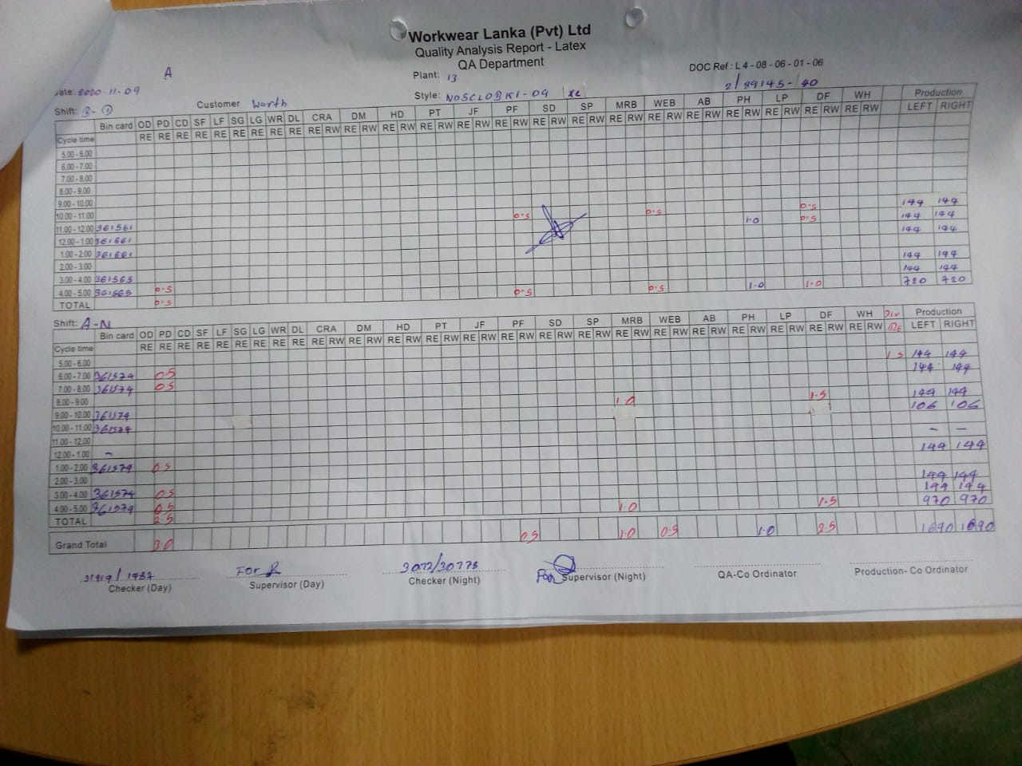




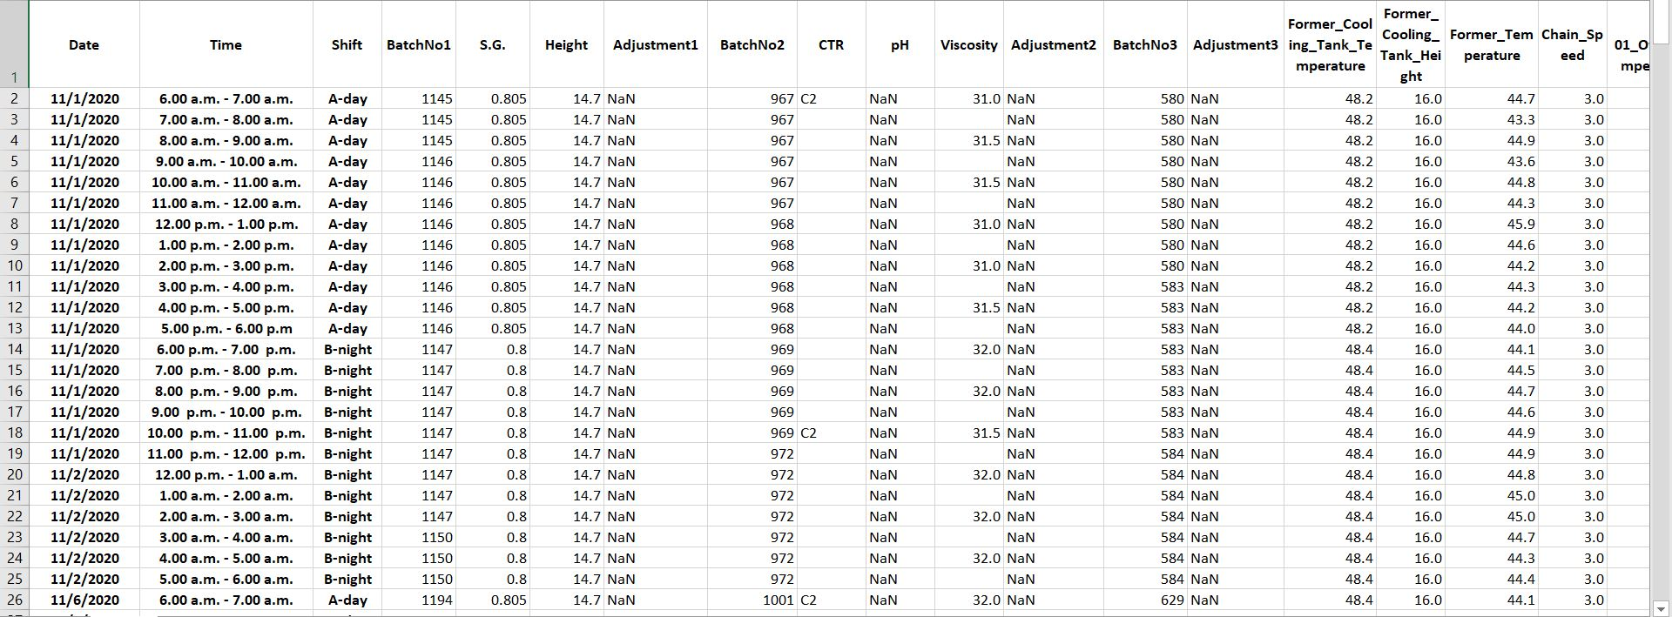
Methodology
1. R Studio
2. Pearson Co-relation Coefficients
3. Plot correlation graphs
Python
Co-relation Analysis
View of original data, manually collected in the factory
Data Preprocessing
Use classification and regression algorithms to build machine learning models.
Load data into csv file
Machine Learning model to optimize dipping process
IT17175012 | Fernando W.M.N.A | 20_21-J 17

Slide 29
View of the original csv file
IT17175012 | Fernando W.M.N.A | 20_21-J 17

Slide 30
1. Descriptive Analyze
df.describe(include='all’)
Count
Unique
Top
Frequency
Mean
Standard Deviation
1st Quartile
2nd Quartile - Median
3rd Quartile
df.skew() – measure for the symmetries of variables
IT17175012 | Fernando W.M.N.A | 20_21-J 17

Slide 31
2. Pre-Processing
Data Cleaning
1. Eliminate unwanted columns.
Ex: Date, Time, Shift
2. Remove columns with missing values
Ex: Tem-01, TDS-01, pH, Adjustment01
3. Fill missing (NaN) values using ffill() method
Ex: Viscosity, CTR, Tem-02, TDS-02
Label encoding
4. Transform categorial data
Ex: CTR, Defect_Occurrence, Rejection
IT17175012 | Fernando W.M.N.A | 20_21-J 17

Slide 32
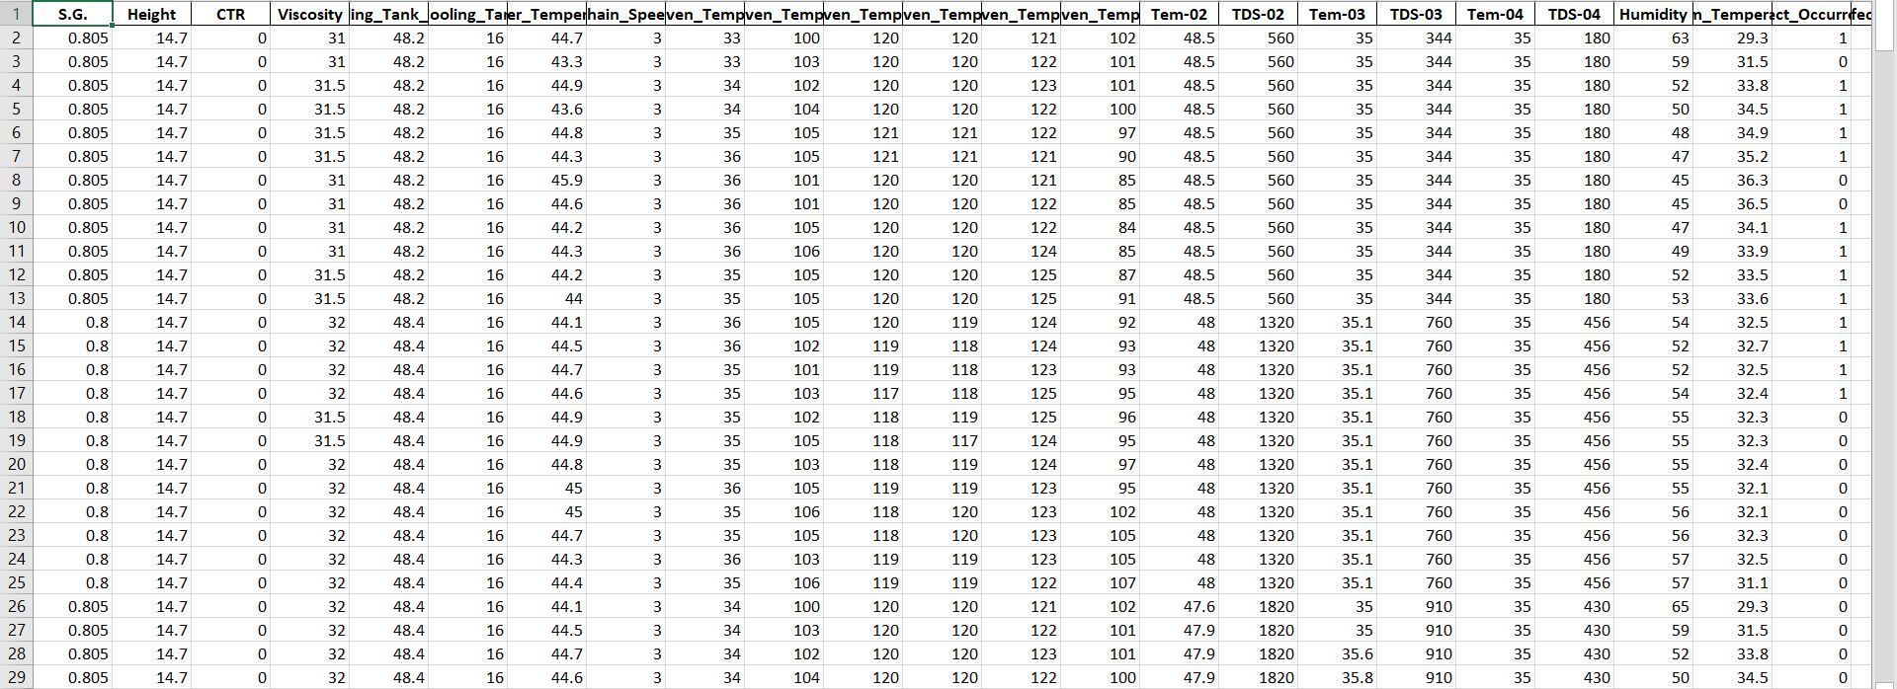
View of the pre-processed csv file
IT17175012 | Fernando W.M.N.A | 20_21-J 17

Slide 33
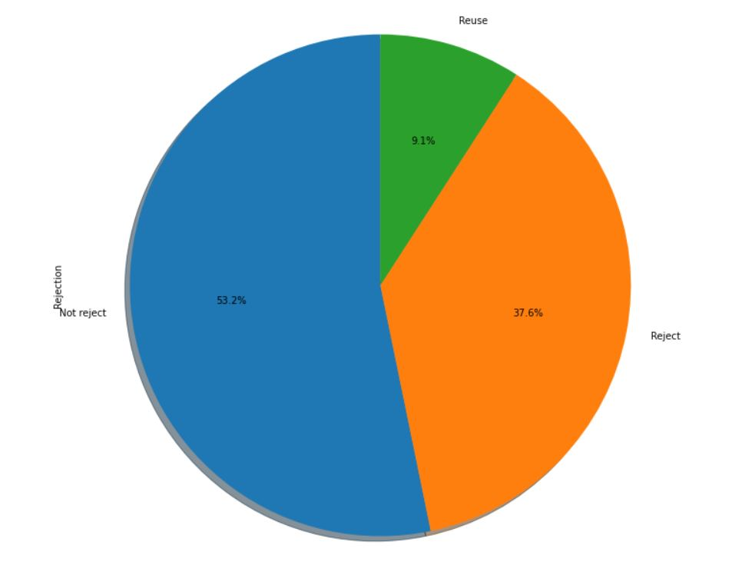
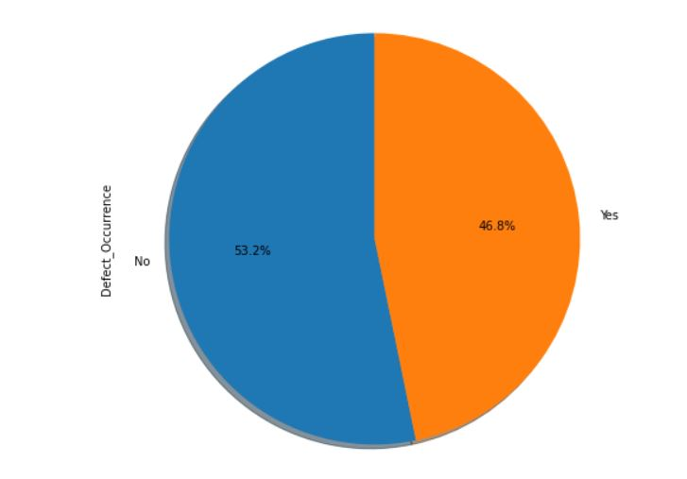
3. Data Visualization
Defect Occurrence Rejection
Defect occurred - 1 No reject - 0
Defect not occurred - 0 Reject- 1
Reuse - 2
IT17175012 | Fernando W.M.N.A | 20_21-J 17

Slide 34
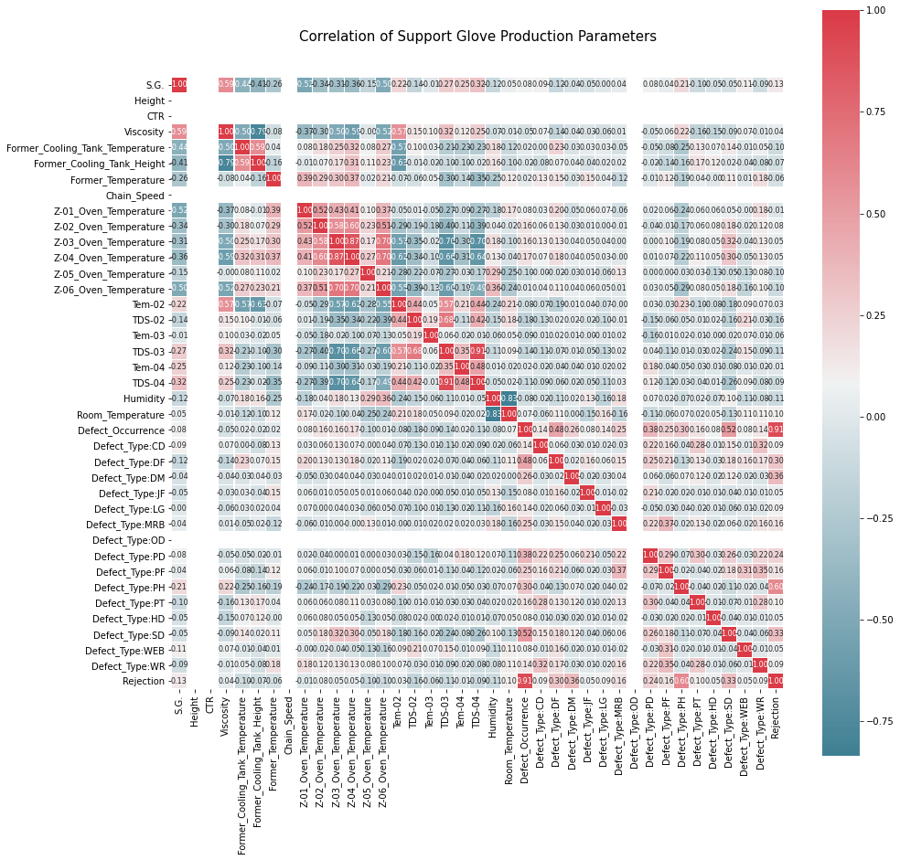
Correlation Plot
IT17175012 | Fernando W.M.N.A | 20_21-J 17

Slide 35
4. Correlation Analyze between plant parameters and environmental factors
Environmental Factors | Plant Parameters
Humidity | CTR
Room Temperature | Viscosity
 | Former Cooling Tank Temperature
 | Former Cooling Tank Height
 | Former Temperature
 | Chain Speed
 | Z-01 Oven Temperature
 | Z-02 Oven Temperature
 | Z-03 Oven Temperature
 | Z-04 Oven Temperature
 | Z-05 Oven Temperature
 | Z-06 Oven Temperature
 | Tem-02
 | TDS-02
 | Tem-03
 | TDS-03
 | Tem-04
 | TDS-04
IT17175012 | Fernando W.M.N.A | 20_21-J 17

Slide 36
Correlation Coefficient for Outer Humidity
CTR, Viscosity, Chain Speed, Z-02 Oven Temperature, Z-04 Oven Temperature, Tem-03, TDS-03, Tem-04, TDS-04 has no correlation with Outer Humidity.
Former Cooling Tank Temperature, Former Cooling Tank Height, Z-03 Oven Temperature, Z-05 Oven Temperature, Z-06 Oven Temperature has positive weak linear relationship with Outer Humidity.
Former Temperature, Z-01 Oven Temperature has a negative weak linear relationship with Outer Humidity.
IT17175012 | Fernando W.M.N.A | 20_21-J 17

Slide 37
2. Correlation Coefficient for Room Temperature
CTR, Viscosity, Former Cooling Tank Temperature, Former Temperature, Chain Speed, Z-02 Oven Temperature, Z-04 Oven Temperature, Tem-03, Tem-04, TDS-04 has no correlation with Room Temperature.
Z-01 Oven Temperature, Tem-02, TDS-02, TDS-03 has positive weak linear relationship with Room Temperature.
Former Cooling Tank Height, Z-03 Oven Temperature, Z-05 Oven Temperature, Z-06 Oven Temperature has a negative weak linear relationship with Room Temperature.
IT17175012 | Fernando W.M.N.A | 20_21-J 17

Slide 38
5. Model Building
Machine Learning Models
Bayesian
Decision Tree
Dimensionality Reduction
Instance Based
Regression
Ensemble
Neural Network
Gaussian Naïve Bayes
Multinomial Naïve Bayes
Linear Discriminant Analysis
K- Nearest Neighbor
Logistic Regression
Random Forest
Gradient Boosting
Ada Boost
Cat Boost
XG Boost
Support Vector Mechanism
1. Split predict variables and response variables
2. Train & test split for predict and response variables
3. Train model with train data
4. Test model with test data
5. Predict accuracy
IT17175012 | Fernando W.M.N.A | 20_21-J 17

Slide 39
6. Accuracy Report
Machine Learning Model | Test Accuracy
Gaussian Naïve Bayes | 0.491071
Multinomial Naïve Bayes | 0.526786
Decision Tree | 0.857143
Linear Discriminant Analysis | 0.651786
K- Nearest Neighbor | 0.848214
Logistic Regression | 0.6875
Random Forest | 0.857143
Gradient Boosting | 0.758929
Ada Boost | 0.705357
Cat Boost | 0.839286
XG Boost | 0.803571
Support Vector Mechanism | 0.669643
Neural Network | 0.8214285969734192
IT17175012 | Fernando W.M.N.A | 20_21-J 17

Slide 40
7. Evaluate Best Model
From the above accuracy the model which got maximum predicted accuracy are,
1. Decision Tree
2. Random Forest
Generate predicted values for best models
8. Improve Decision Tree Model using Genetic Algorithms
IT17175012 | Fernando W.M.N.A | 20_21-J 17

Slide 41
Tools & Technologies
Python
TensorFlow
Keras
R programming
R Studio
Anaconda
Windows 10
Git Version Controlling
IT17175012 | Fernando W.M.N.A | 20_21-J 17

Slide 42
Requirements
User
Identify the external plant parameters, which contributes to dipping process
Co-relations between plant parameter and environmental parameters
Functional
Software & Technologies
Development Environments
Non-Functional
Reliability
Usability
Performance
Availability
Product Requirements
External Requirements
Company Ethics
Company Regulations
Optimize the supported glove production by controlling conditions which causes for
Machine learning model to optimize defect occurrence
Machine learning model to optimize glove rejection.
defects occurred during ongoing production.
IT17175012 | Fernando W.M.N.A | 20_21-J 17

Slide 43
Commercial Value
Reduce defect occurrence in final supported gloves
Accurate co-relation analyze
Identify defect occurrence by analyzing production parameters using machine learning
Product
Customer
Applicable for production processes which depend on plant parameters
Future Demand
IT17175012 | Fernando W.M.N.A | 20_21-J 17

Slide 44
References
[1] P. Jirasukprasert, J.A. Garza-Reyes, V. Kumar, Ming K. Lim. (2014, February). “A Six Sigma and DMAIC application for the reduction of defects in rubber gloves manufacturing process” International Journal of Lean Six Sigma [Online]. vol. 5, issue 1, pp. 2-21. Available: https://www.researchgate.net/publication/263418063_A_Six_Sigma_and_DMAIC_application_for_the_reduction_of_defects_in_a_rubber_gloves_manufacturing_process.pdf
[2] K. Singh. (2016, July). “Defects Reduction Using Root Cause Analysis Approach in Gloves Manufacturing Unit” International Research Journal of Engineering and Technology (IRJET) [Online]. vol. 3, issue 7, Available: https://d1wqtxts1xzle7.cloudfront.net/54527416/IRJET-V3I733.pdf?1506327927=&response-content-disposition=inline%3B+filename%3DDefects_Reduction_Using_Root_Cause_Analy.pdf&Expires=1595227514&Signature=CvhM4zTgBLMAEipRrtuB2n9mYzztdWhaL1FzMB4ncMTYsh15ojX0OKPzirEufuCREXR7QzjPRp6HtZGQgsFyEgsqwSZ2DHMj36MeLEQ-GOpbMj4THNeUDTE9JmP3UgQ3Kn8Hi6fBGZq1hFCeOGM-0xMZqtqSJl1DLrMJmNjKpWitbjlyiJ61tyVFypO0NwJwPoU~o4DgIyUOhuicG3-PNzaJHofZ7xHBskkcvVXNOn8PXNIAxBcNWZNYXrdfC~V-JVVfMxv9B2RtZNC-oMcO05QWhF4fc9XCuvEBiY6ZNBJDSXfUB6jHEThkFI0uvY7CvCbTt4v7pMod09ExZndOSA__&Key-Pair-Id=APKAJLOHF5GGSLRBV4ZA.pdf
[3] M.C. Ng, H. Ab-Samat, S. Kamaruddin. (2013, June). “Reduction of Defects in Latex Dipping Production: A Case Study in a Malaysian Company for Process Improvement” The International Journal Of Engineering And Science (IJES) [Online]. vol. 2, issue 6, Pp. 1-11. Available: http://www.theijes.com/papers/v2-i6/Part.2/A026201011.pdf
[4] L. Than, S.W. Phang, K.N. Ho, “Coagulant Dipping Time and Temperature Optimisation for Latex Glove Uneven Coating Investigation” in Conf. of Material Science, 2018 Selangor, Malaysia [Online]. Available: https://www.semanticscholar.org/paper/Coagulant-Dipping-Time-and-Temperature-Optimisation-Than-Phang/53931b71376196367603d0c5a2674492e31f4382
[5] S. Amdur, “VISCOSITY ENHANCED NATURAL RUBBER LATEX DIPPING MEDIA AND DIPPED ARTICLES OF GREATER THICKNESS PREPARED THEREFROM,” U.S. Patent 2002/0156159 A1, 24 Oct. , 2002
[6] K. K. Sasidharan, R. Joseph, G. Rajammal, P. V. Pillal, K. S. Gopalakrishnan. (2001, July). “Studies on the Dipping Characteristics of RVNRL and NR Latex Compounds”. Applied Polymer Science [Online]. vol. 81, issue 13, Pp. 3141-3148. Available: https://www.researchgate.net/publication/230290172_Studies_on_the_dipping_characteristics_of_RVNRL_and_NR_latex_compounds
[7] W.S.C.Wong. “CURRENT TREND IN LATEX DIPPED PRODUCTS MANUFACTURING”, Malaysia, 1996, pp. 145-148.
[8] B. Howe. “An Update on Automation Technology For Latex Dip Molded Products and Coatings,” in Conf. of International Latex, USA, 2009, pp. 1-19.
[9] V. Folvik. “How to use machine learning for production optimization.” Towardsdatascience.com. https://towardsdatascience.com/machine-learning-for-production-optimization-e460a0b82237
[10] M. Franzese, A. Luliano, “Correlation Analysis,” Encyclopedia of Bioinformatics and Computational Biology, vol. 1, p. 706-721, January 2019. [Abstract]. Available: https://www.sciencedirect.com/science/article/pii/B9780128096338203580
[11] Global Market Insights. (2019, Sep.). Industry Trends [online]. Available: https://www.gminsights.com/industry-analysis/industrial-safety-gloves-market
[12] Z. Bandar, H. Al-Attar and D. McLean, "Genetic algorithm based multiple decision tree induction," ICONIP'99. ANZIIS'99 & ANNES'99 & ACNN'99. 6th International Conference on Neural Information Processing. Proceedings (Cat. No.99EX378), Perth, WA, Australia, 1999, pp. 429-434 vol.2, doi: 10.1109/ICONIP.1999.845633.
[13] Ngoc-Tu Nguyen, Jeong-Min Kwon and Hong-Hee Lee, "Fault diagnosis of induction motor using decision tree with an optimal feature selection," 2007 7th Internatonal Conference on Power Electronics, Daegu, Korea (South), 2007, pp. 729-732, doi: 10.1109/ICPE.2007.4692484.
[14] N. A. Pakri, A. R. Hussain and K. A. Kasmiran, "Linear machine weight adaptation in a genetic programming classifier that classifies medical data," 2008 International Conference on Computer and Communication Engineering, Kuala Lumpur, Malaysia, 2008, pp. 236-240, doi: 10.1109/ICCCE.2008.4580603.
[15] Kyoung Min Kim, Byung Jin Lee, Kyoung Lyou and Gwi Tae Park, "Design of a binary decision tree using the genetic algorithm and K-means algorithm for recognition of the defect patterns of cold mill strip," FUZZ-IEEE'99. 1999 IEEE International Fuzzy Systems. Conference Proceedings (Cat. No.99CH36315), Seoul, Korea (South), 1999, pp. 1081-1085 vol.2, doi: 10.1109/FUZZY.1999.793104.
[16] Florian Eger, Colin Reiff, Bernd Brantl, Marcello Colledani, Alexander Verl, Correlation analysis methods in multi-stage production systems for reaching zero-defect manufacturing, Procedia CIRP, Volume 72, 2018, Pages 635-640, ISSN 2212-8271, Available: https://www.sciencedirect.com/science/article/pii/S2212827118303214
[17] Deborah R. Carvalho, Alex A. Freitas, A hybrid decision tree/genetic algorithm method for data mining, Information Sciences, Volume 163, Issues 1–3, 2004, Pages 13-35, ISSN 0020-0255, Available : https://www.sciencedirect.com/science/article/pii/S0020025503004146
[18] Wang, KS. Towards zero-defect manufacturing (ZDM)—a data mining approach. Adv. Manuf. 1, 62–74 (2013). https://doi.org/10.1007/s40436-013-0010-9
IT17175012 | Fernando W.M.N.A | 20_21-J 17

Slide 45
IT17182188 | RATHNAYAKE R. M. M. G.
DATA SCIENCE
IT17182188 | Rathnayake R. M. M. G. | 20_21-J17

Slide 46
Background study.
Site visit .
Data collection
Desktop application design
Data pre-process
Correlation analyze between parameters
Machine learning model implementation
Overall Progress
Completed tasks
On going tasks
Tasks yet to start
IT17182188 | Rathnayake R. M. M. G. | 20_21-J17

Slide 47
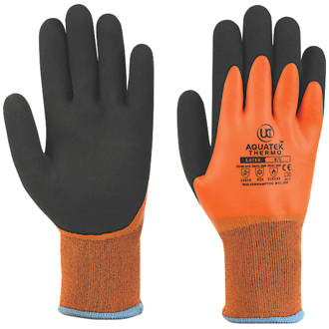
Background
Maidas safety has provided products to more than 50 countries over the last 40 years.
Supportive glove : yarn shell and latex
Basically use 03 main chemicals during manufacturing process :
Latex
Solvent
Methanol
They release chemicals according to manual calculations. Chemical
consumption may be deviate time to time.
They import these expensive chemicals. Waste happened.
No proper chemical consumption handling process
No. of yarns in shell
Yarn type
Humidity
Room temperature
Former temperature

Slide 48
Problem
Chemical waste happened.
IS THERE ANY RELATIONSHIP BETWEEN CHEMICAL CONSUMPTION & PARAMETERS
How to optimize the chemical consumption during the glove manufacturing process
No of yarns in shell
Yarn type
Humidity
Room temperature
Former temperature
IT17182188 | Rathnayake R. M. M. G. | 20_21-J17

Slide 49
Gap
Most of the researches are focused about optimize raw material inventory consumption or the raw material price forecasting.
This solution focused about ongoing production line and its chemical consumption and try to optimize the raw material consumption.
IT17182188 | Rathnayake R. M. M. G. | 20_21-J17

Slide 50
Objectives
Study about the chemicals which are used for glove manufacturing process
Build desktop application for effectively manage the chemical consumption of glove manufacturing by using machine learning model within 9-month period
Get the correlation between chemicals consumption and parameters
Building the Machine Learning model to optimize the chemical consumption during the manufacturing
IT17182188 | Rathnayake R. M. M. G. | 20_21-J17

Slide 51
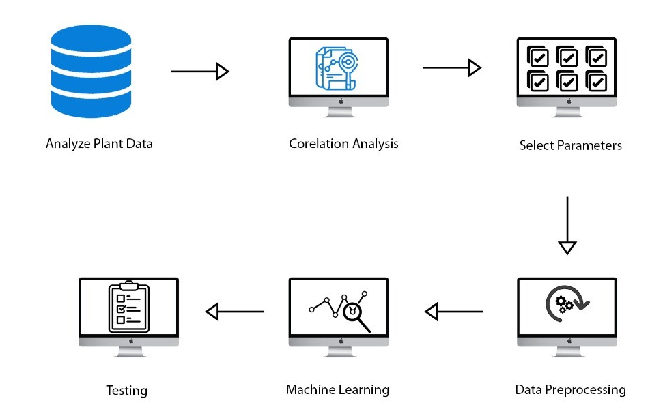
Methodology
1.System Diagram
IT17182188 | Rathnayake R. M. M. G. | 20_21-J17

Slide 52
2. Data Preprocessing
1.Fill null values
df.fillna(method='ffill')
2.Drop empty rows
df.dropna() : this Pandas function used
3.Data Resampling
Increase the number of rows
4.Data Normalization
convert data into common scale

Slide 53
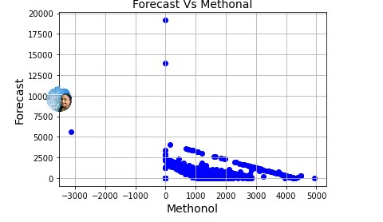
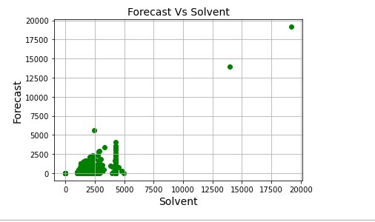
3.Data Visualization and Correlation analysis
Run a series of correlation analysis with following parameter:
Methanol vs Humidity, Ambient temp, former temp, #of Yarns, Yarn Type
Latex vs Humidity, Ambient temp, former temp, #of Yarns, Yarn Type
Solvent vs Humidity, Ambient temp, former temp, #of Yarns, Yarn Type

Slide 54
4. Model Implementation
Creates a Linear model from keras
Get cleaned data to the dataframe
Load the data to the Linear model and train
Validate and test accuracy
Save trained model

Slide 55
Requirements
User Requirement
Functional Requirement
Non-functional Requirement
Reliability
Co-relation analysis
Optimize the chemical consumption
Availability
Usability
Performance
Python
Git version control
Spider IDE
Anaconda
TensorFlow
User Requirements
Functional Requirements
Non-Functional Requirements
IT17182188 | Rathnayake R. M. M. G. | 20_21-J17

Slide 56
Commercial Value
Product
MAIDAS SAFETY manufacturer can use correlation analysis to identify the root causes of the chemical consumption and machine learning models can apply to optimize the chemical consumption in their glove manufacturing. Global Industrial Safety Gloves Market size was worth over USD 5 billion in 2018 and will witness CAGR over 7% up to 2025..
Modern organizations tend to use machine learning techniques due to efficiency and it also can be used in various industries to optimize the raw material consumption. This method will save company resources and increase its productivity and profits
Reduce the manufacturing down time
Customer
Future Demand
IT17182188 | Rathnayake R. M. M. G. | 20_21-J17

Slide 57
References
1. Baskar G and Ramamoorthy NV (2004). Artificial Neural Network: an Efficient Tool to Simulate the Profitability of State Transport Undertakings. Indian J Transport Manage 28(2):243–257. 2. Chang HC (2004). An Application of Fuzzy Sets Theory to the EOQ model with Imperfect Quality Items. Computers & Operations Research 31:2079–2092. 3. Chat S Konak A and Smith AE (2002). Estimation of All-terminal Network Reliability Using an Artificial Neural Network. Computers and Operations Research 29:849-868. 4. Chiu YP (2003). Determining the Optimal Lot Size for the Finite Production Model with Random Defective Rate, the Rework Process, and Backlogging. Engineering Optimization 35(4): 427–437. 5. Ezugwu EO Fadare DA Bonney J Da Silva RB and Sales WF (2005). Modelling the correlation between cutting and process parameters in high speed machining of Inconel 718 alloy using an artificial neural network. International Journal of Machine Tools and Manufacture 45(12/13): 1375-1385. 6. Fonseca DJ and Navaresse D (2002). Artificial Neural Networks for Job Shop Simulation, Advanced Engineering Informatics 16: 241-246. 7. Koh SG Hwang H Sohn KI and Ko CS (2002). An Optimal Ordering and Recovery Policy for Reusable Items. Computers and Industrial Engineering. 43:59–73. 8. Lotfi K G Choueiki MH (2000). A Neural Network Model for Solving the Lot Sizing Problem. Omega, 28: 175-184. 9. Lawrence M and Fredrickson J (1998). Brain Maker User’s Guide and Reference Manual, 7th Edition. California Scientific Software Press, Nevada City, CA.
IT17182188 | Rathnayake R. M. M. G. | 20_21-J17

Slide 58
IT17175944 | HATHNAPITIYA H.G.P.G.R.K.
COMPUTER SYSTEMS AND
NETWORK ENGINEERING
IT17175944 | HATHNAPITIYA H.G.P.G.R.K. | 20_21-J 17

Slide 59
Research component identification
Site visit
Gather Background information
Testing
Implement data warehouse
Build low-cost protocols
Client application
Overall Progress
Completed tasks
On going tasks
Tasks yet to start
IT17175944 | Hathnapitiyage H.G.P.G.R.K| 20_21-J 17

Slide 60
Background
The company data communication system based on the wired ethernet network.
The Modbus TCP communication protocol run within the main server and the PLC (Programmable Logic Controller)
The company doesnot support centralized data management system. They get support from cloud service providers (AWS).
IT17175944 | HATHNAPITIYA H.G.P.G.R.K. | 20_21-J 17

Slide 61
Problem
How the data communication system build with wireless protocol to achieve reliability, low cost and secure?
Is the Programmable Logic Controller (PLC) module support for wireless protocol with encryption and authentication algorithm?
The company need enhance performance for data analyzing process. So how the centralized offline method used for support warehouse concept?
IT17175944 | HATHNAPITIYA H.G.P.G.R.K. | 20_21-J 17

Slide 62

Gap
 | Build wireless communication protocol (Proposed system) | Coverage problem for wireless sensor network | Green community control network protocol | Design on routing protocol in hybrid wireless network | Design and implementation of wireless PLC system | A new challenge in ecological process control based on PLCs with profinite communication protocol | Wireless Network application in real-time automation systems | Wireless control and monitoring using PLC
Security
Reliability
Low cost
Research
Function
IT17175944 | HATHNAPITIYA H.G.P.G.R.K. | 20_21-J 17

Slide 63
Objectives
Build communication Protocol
Establish secure, reliable and low-cost
protocol
Develop data warehouse and establish communication protocol to improve network performance according to the company requirement
Data warehouse implementation
- to manage the data, for enhance the decision-making capabilities using report
IT17175944 | HATHNAPITIYA H.G.P.G.R.K. | 20_21-J 17

Slide 64
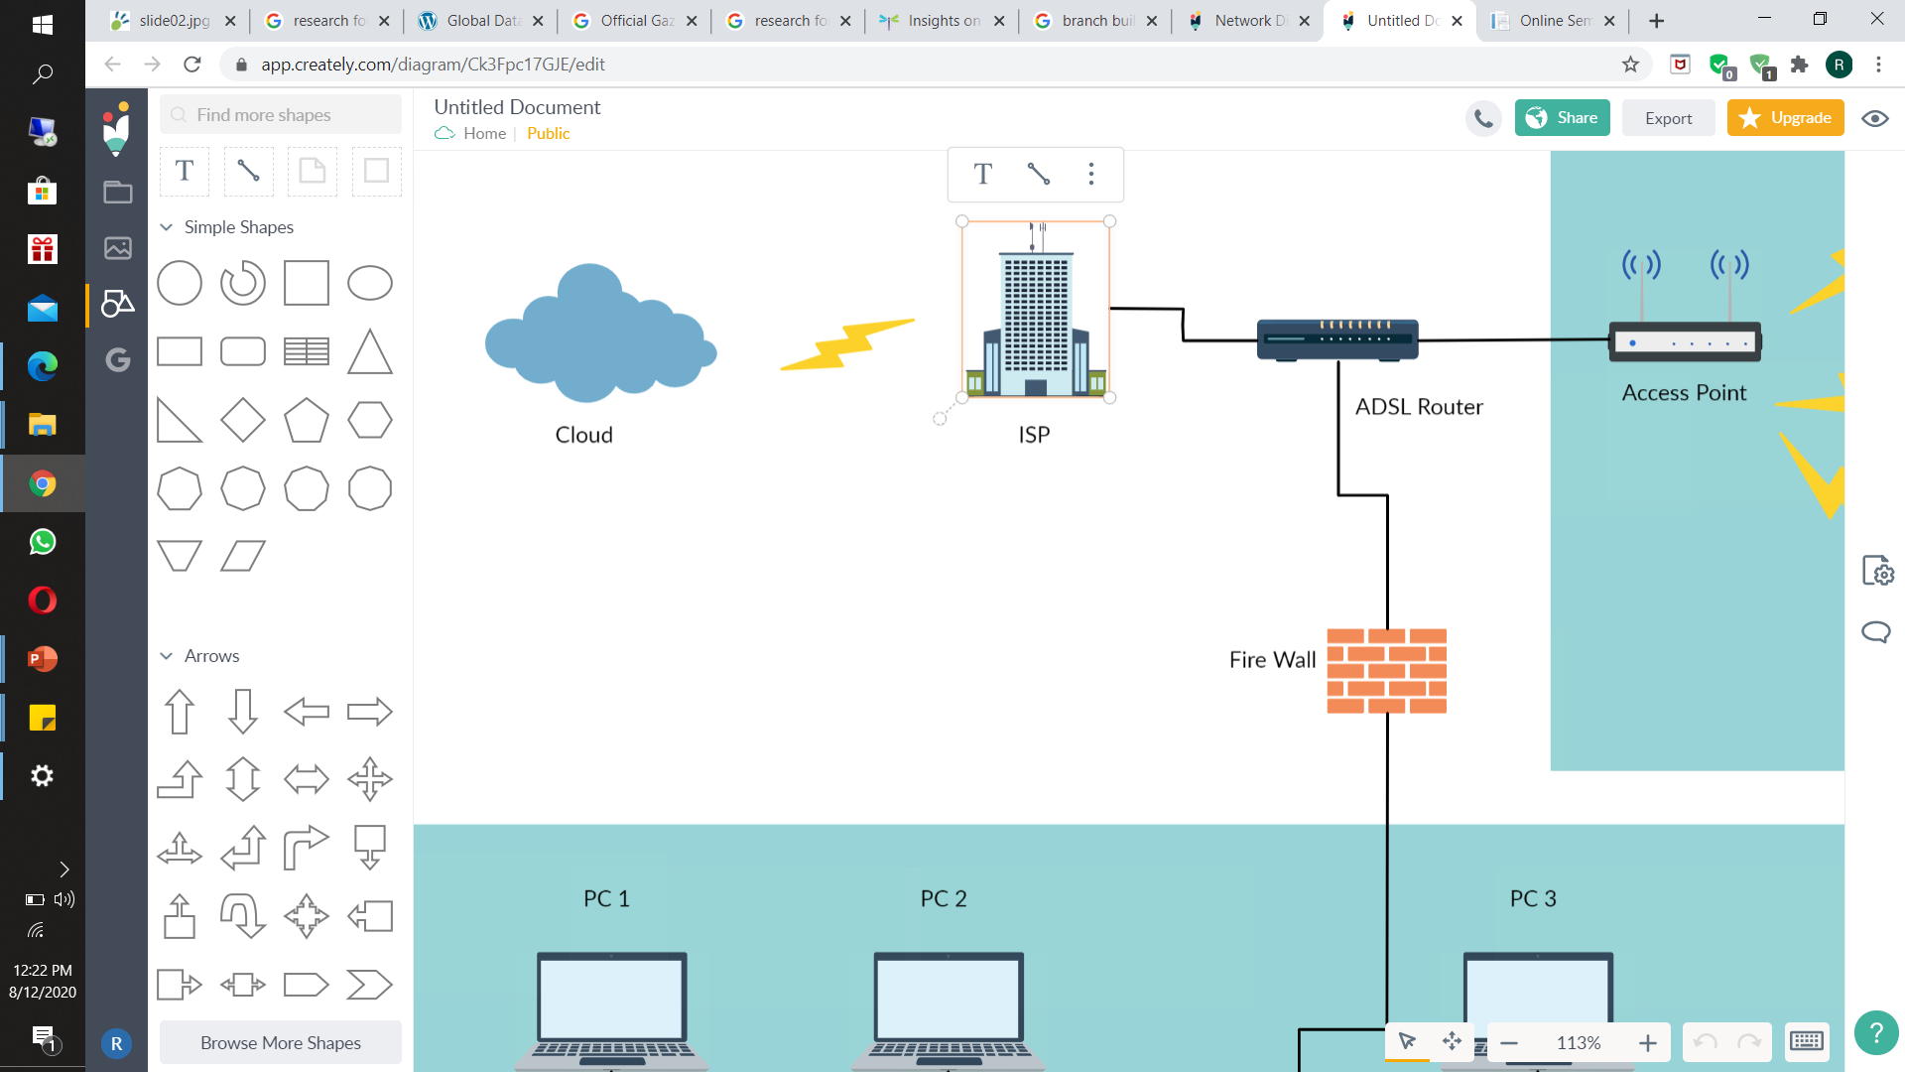
Methodology
Wireless Communication Protocol
CRM
PLC
Programmable Logic Controller
Staging area
Operational system
Flat files
Druid
Head Branch
Data Warehouse
OLAP cube
Reporting
IT17175944 | HATHNAPITIYA H.G.P.G.R.K. | 20_21-J 17

Slide 65
Information gathering about the current network infrastructure
Using the questionnaire, identified
Existing network infrastructure
What are the issues in wired communication
What type of protocol they request
Why the wireless solution they required
What are the main point to be considered
IT17175944 | HATHNAPITIYA H.G.P.G.R.K. | 20_21-J 17

Slide 66
Observing the wireless communication protocol
 | WEP | WAP2 | WAP3
Encryption method | RC4 (Rivest Cipher 4) CRC – 32 (Cyclic Redundancy Check) | AES-CCMP encryption | AES DES
Authentication method | Open System Authentication Shared Key Authentication | Preshared key(PSK) | Server authentication
IT17175944 | HATHNAPITIYA H.G.P.G.R.K. | 20_21-J 17

Slide 67
Coding based on different type of algorithm
using java language
Diffie-Helman Key Exchange
DES (Data Encryption Standard)
Digital signature Algorithm
RC4 (Rivest Cipher)
AES (Advanced Encryption standard)
MD5 (Message Digest)
HMAC (Hash-based Message Authentication Method)
IT17175944 | HATHNAPITIYA H.G.P.G.R.K. | 20_21-J 17

Slide 68
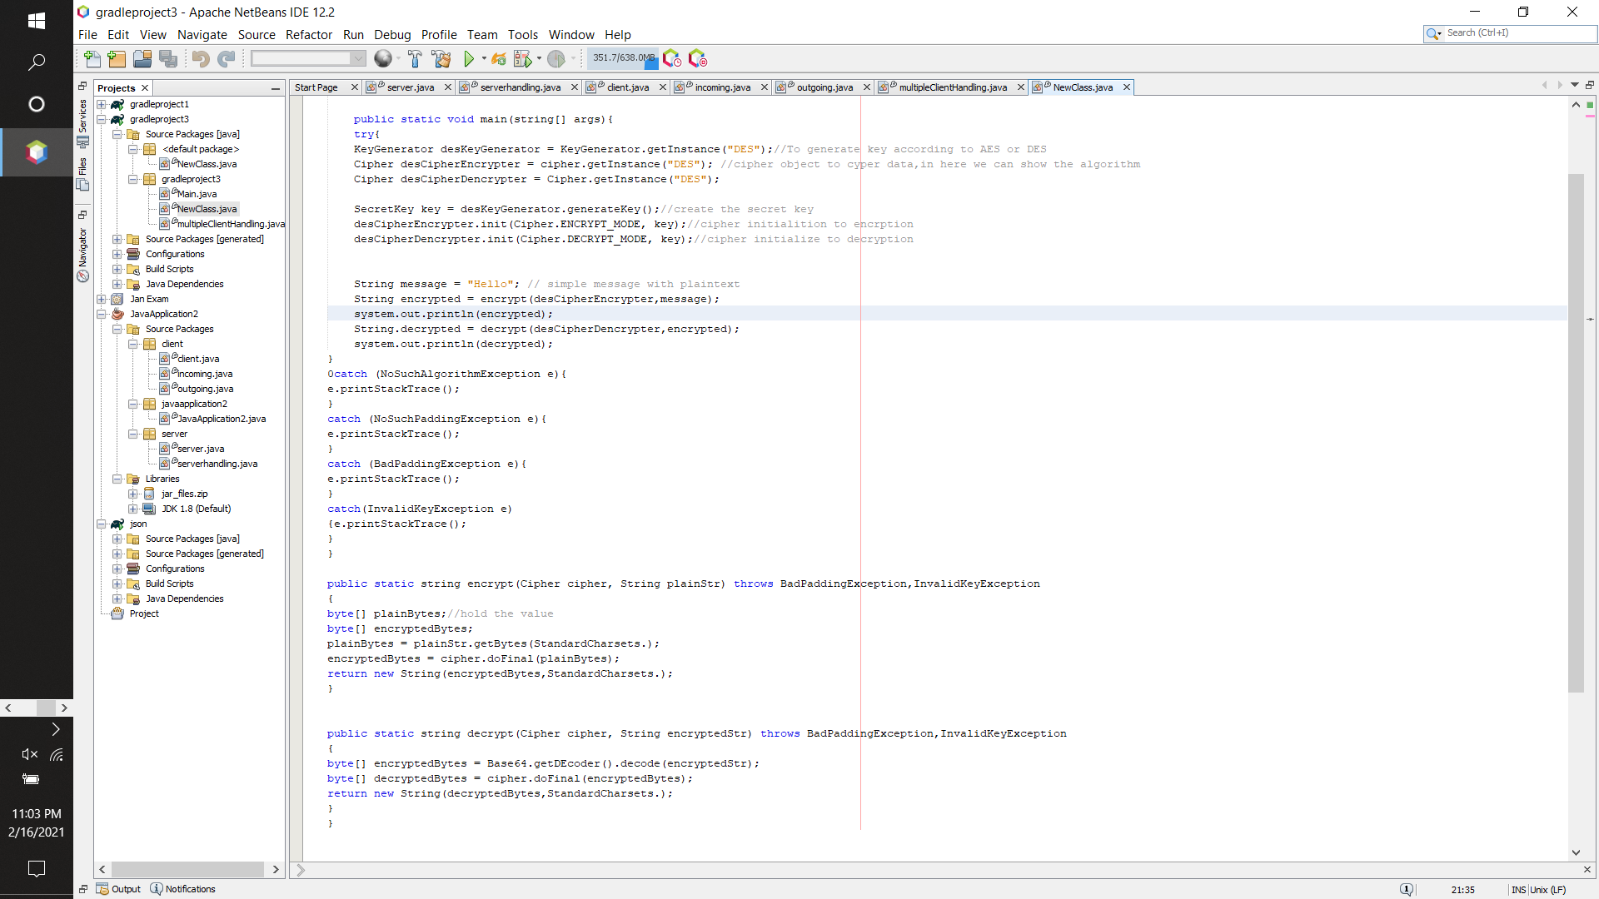
Java coding for DES
IT17175944 | HATHNAPITIYA H.G.P.G.R.K. | 20_21-J 17

Slide 69
Apache Druid Data Warehouse Tool
Apache druid is the data warehouse which is specially design for fast OLAP operation for large data set.
Druid architecture supports the data warehousing concept, time series data bases and log search systems.
Some of key features are,
Columnar storage format
Cloud native fault tolerance Architecture
No data loss
Massively parallel processing
Support approximate Algorithm
fast query latencies
IT17175944 | HATHNAPITIYA H.G.P.G.R.K. | 20_21-J 17

Slide 70
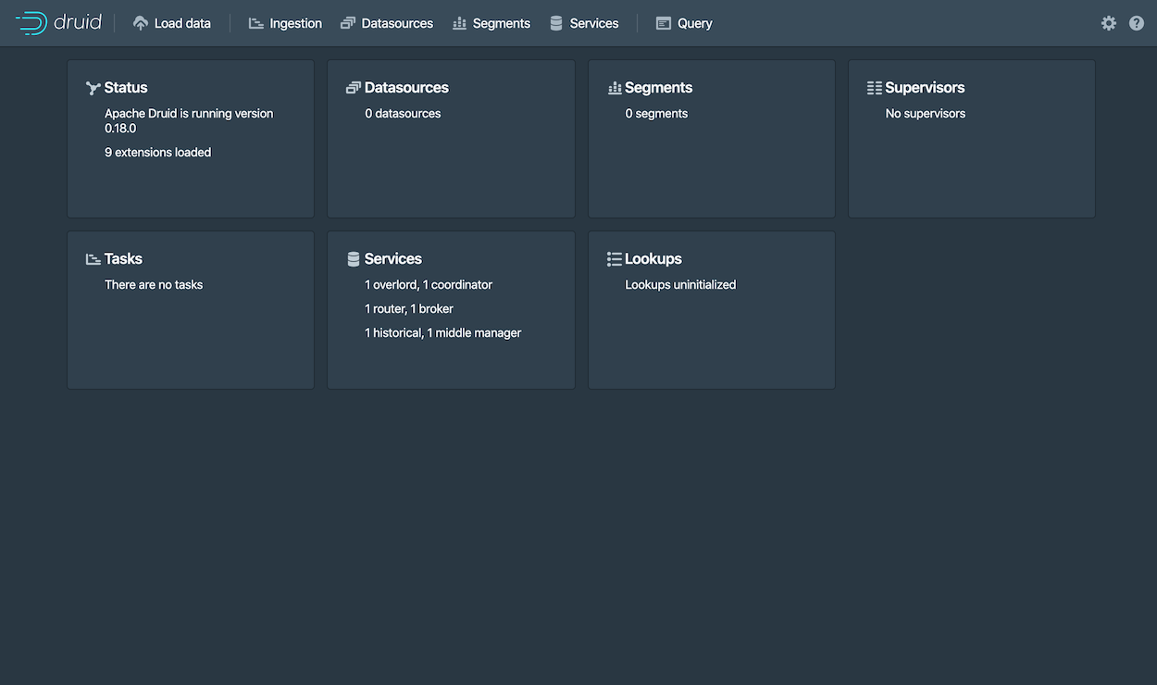
IT17175944 | HATHNAPITIYA H.G.P.G.R.K. | 20_21-J 17

Slide 71
Requirements
User Requirement
Generate report quickly
Effectively and efficient way for data communication
End user client application
Functional Requirement
Reliability
Fault tolerance
Low cost
Security
Integrated with massive and elastic storage
Non-functional Requirement
Company rules
Legal policies
IT17175944 | HATHNAPITIYA H.G.P.G.R.K. | 20_21-J 17

Slide 72
Tools and Technology
Java Language
PLC (Programmable Logic Device)
NetBeans
Apache Druid
SQL
IT17175944 | HATHNAPITIYA H.G.P.G.R.K. | 20_21-J 17

Slide 73
Commercial Value
Low-cost protocol with reliability and security
Product
Improve the decision-making capabilities
Reliable and secure data communication
Customer
Applicable for the
Industrial machinery infrastructure
Future Demand
IT17175944 | HATHNAPITIYA H.G.P.G.R.K. | 20_21-J 17

Slide 74
References
[1] "Midas Safety Healthcare", Midassafety.healthcare, 2020. [Online]. Available: http://www.midassafety.healthcare/about. [Accessed: 22- Jul- 2020]
[2] R. Breitmeyer, "What are the 7 disadvantages to a manual system?", Linkedin.com,2020.[Online].Available:https://www.linkedin.com/pulse/what -7-disadvantages-manual-system-richard-breitmeyer. [Accessed: 23- Jul2020].
[3] Stefano Rizzi, “Research in data warehouse modeling and design: dead or alive?”,(2006)[Online].Available:https://www.researchgate.net/publication/2 20933865. [Accessed: 26-Jul.-2020].
[4] C. Milanes, H. Tamayo , D. de Oliveira , and J. R. Nunez, "ShieldSquare Captcha",In Proc. IOP Conference Series: Materials Science and Engineering.
[5] M. Muniswamaiah, T. Agerwala, and C. Tappert, “Big Data in Cloud Computing Review and Opportunities”, International Journal of Computer Science & Information Technology (IJCSIT) Vol 11, No 4, August 2019.
[6] k. Tomingas, “Semantic Data Lineage and Impact Analysis of Data Warehouse ...”, Doctoral Thesis, TALLINN UNIVERSITY OF TECHNOLOGY, Tallinn, may 21, 2018.
[7] Shastri L Nimmagadda, and Heinz Dreher, “Mapping and Modeling of Oil and Gas Relational Data Objects for Warehouse Development and Efficient Data Mining”, ” In Proc. IEEE International Conference on Industrial Informatics, 2006, pp. 1201-1206.
[8] Shastri L Nimmagadda, and Heinz Dreher, “New directions for warehousing data management research ...”, In Proc. IEEE International Conference on Industrial Infrormatics’, 2006.
[9] A. Berglund “On the Understanding of Computer Network Protocols”, IT Licentiate thesis, Uppsala University, Uppsala, Sweden, 2002.
[10] Yunlai Xu, Shushi Gu, Zhihua Yang, Qinyu Zhang, “Relay Buffer Assisted DTN Bundle Protocol Design via Network ...”, In Proc. IEEE/CIC International Conference on Communications Workshops in China, 2019
[11] “1888-2014 - IEEE Standard for Ubiquitous Green Community ...”, In Proc. ISO/IEC/ IEEE 18880, 15,4,2015.
[12] R. Elhabyan, Wei Shi, and Marc St-Hilaire, “Coverage protocols for wireless sensor networks: Review and future ...”, Journal Of Communications And Networks, Vol. 21, No. 1, February 2019. 21
[13] Raufu Olalekan Omodara, “Design of Data Warehouse and Business Intelligence System ...”, Thesis, School of Computing, Blekinge Institute of Technology, SE-371 79 Karlskrona, Sweden, June 2011.
[14] F. Ziyah, “Data Warehouse Design for Electronic Manufacturing Company”, International Journal of Computer Trends and Technology (IJCTT) – Volume 56 Number 1- February 2018.
IT17175944 | HATHNAPITIYA H.G.P.G.R.K. | 20_21-J 17

Slide 75
Thank You

